Slide 1



Cognitive Rational Intelligent Agents
In Infrastructure
Triet Pham ATC

Slide 2


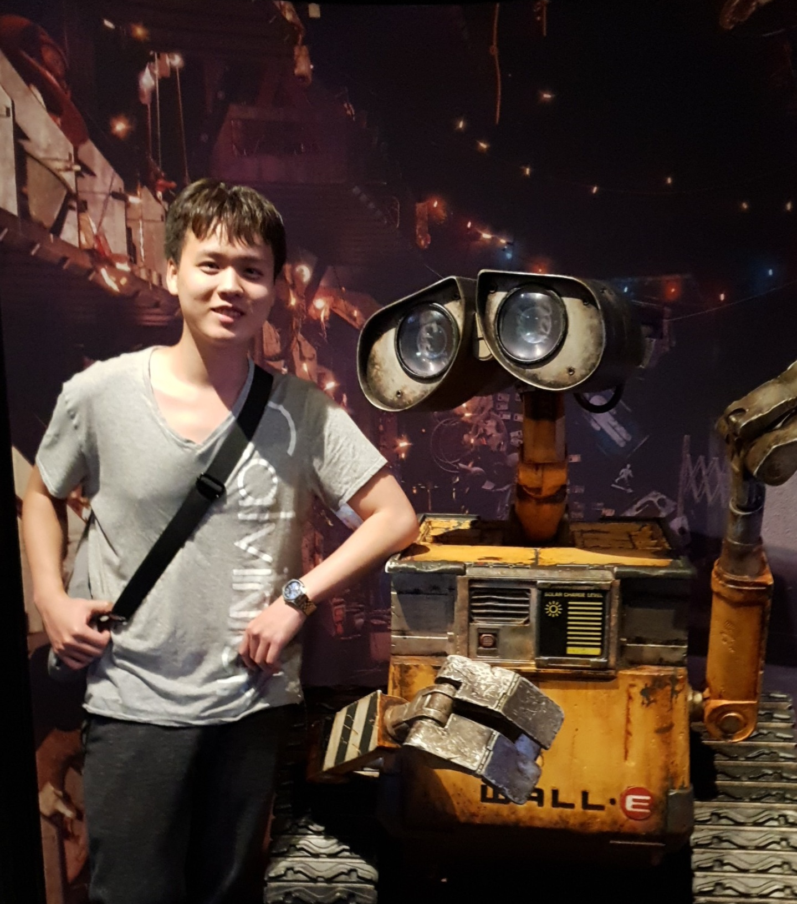




Slide 3
Agenda & Objectives
Agenda
Objectives
Explanation of Cognitive Rational Intelligent Agents.
Business Use Case 1: VMWare Infrastructure
Business Use Case 2: Database Infrastructure
Wrapping up, Takeaways, Q&A
After completing this session, you should be able to:
Describe what Intelligent Agents are.
Identify key problems within VMWare and how to apply Intelligent Agents concepts such as perception, working memory, knowledge representation, and most importantly complex reasoning.
Be inspired and start thinking about how to apply Intelligent Agents into your own work and businesses.

Slide 4
Artificial Intelligence
Intelligent Agents
Cognitive Abilities:
Perception
Reasoning & Decision Making
Attention
Working Memory
Machine Learning
Cognitive Abilities:
Pattern Recognition
Learning
Language understanding
Visual & spatial processing

Slide 5
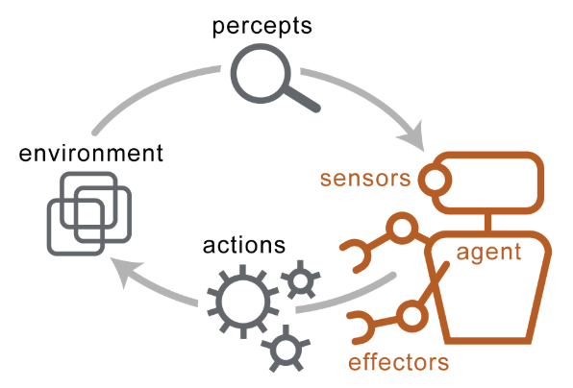
It’s about building “Autonomous Entity”

Slide 6
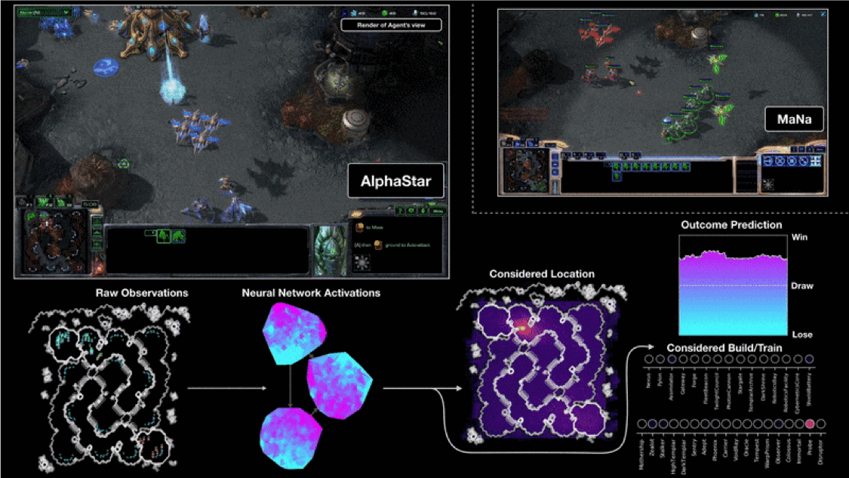
Deepmind AlphaStar AI plays StarCraft 2
Source: https://deepmind.com/blog/alphastar-mastering-real-time-strategy-game-starcraft-ii/
Notes:
Start vid at 1:12:05

Slide 7

Working Memory
Process new information.
Compare / contrast / mix with information already known.
Memory needs to be filtered & processed such that decision making mechanism can utilize it.

Slide 8
Working Memory Exercise

Slide 9

Question
Our VMWare infrastructure supports $ _____ in UHG business yearly.
10 Million
100 Million
1 Billion
100 Billion
Answer: $100 Billion

Slide 10
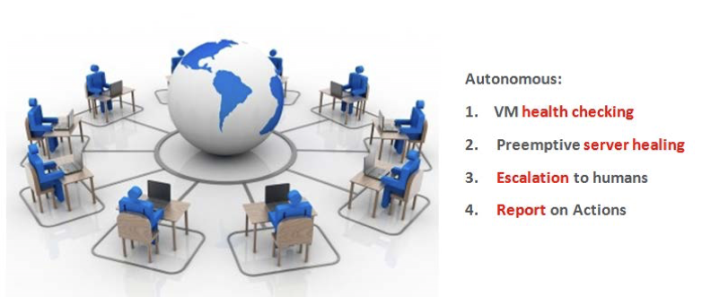
VMWare Infrastructure Use Case
Agents will work autonomously and collaboratively across an entire network of
VMWare instances to increase stability of the infrastructure.

Slide 11
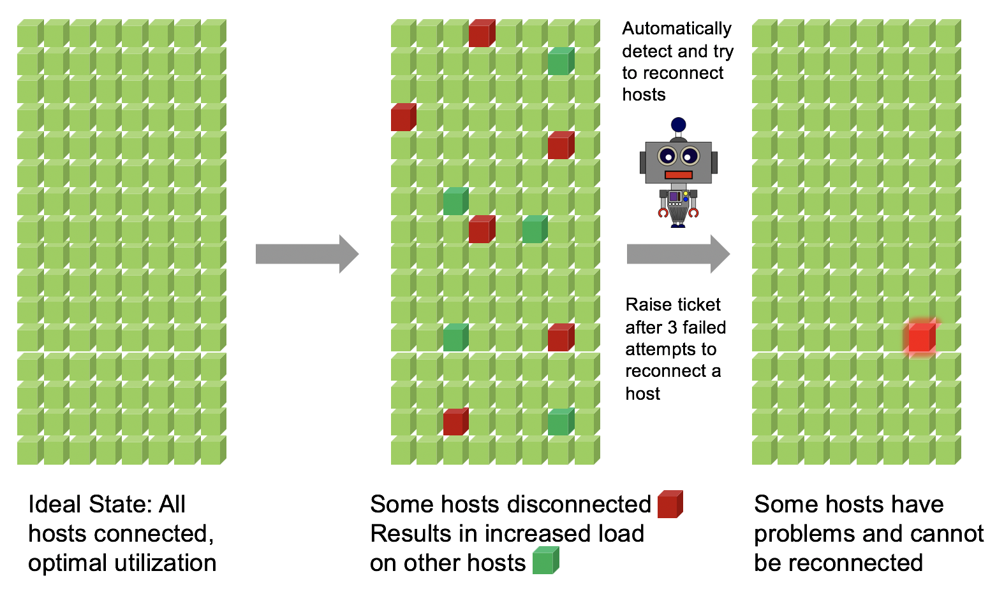

Slide 12
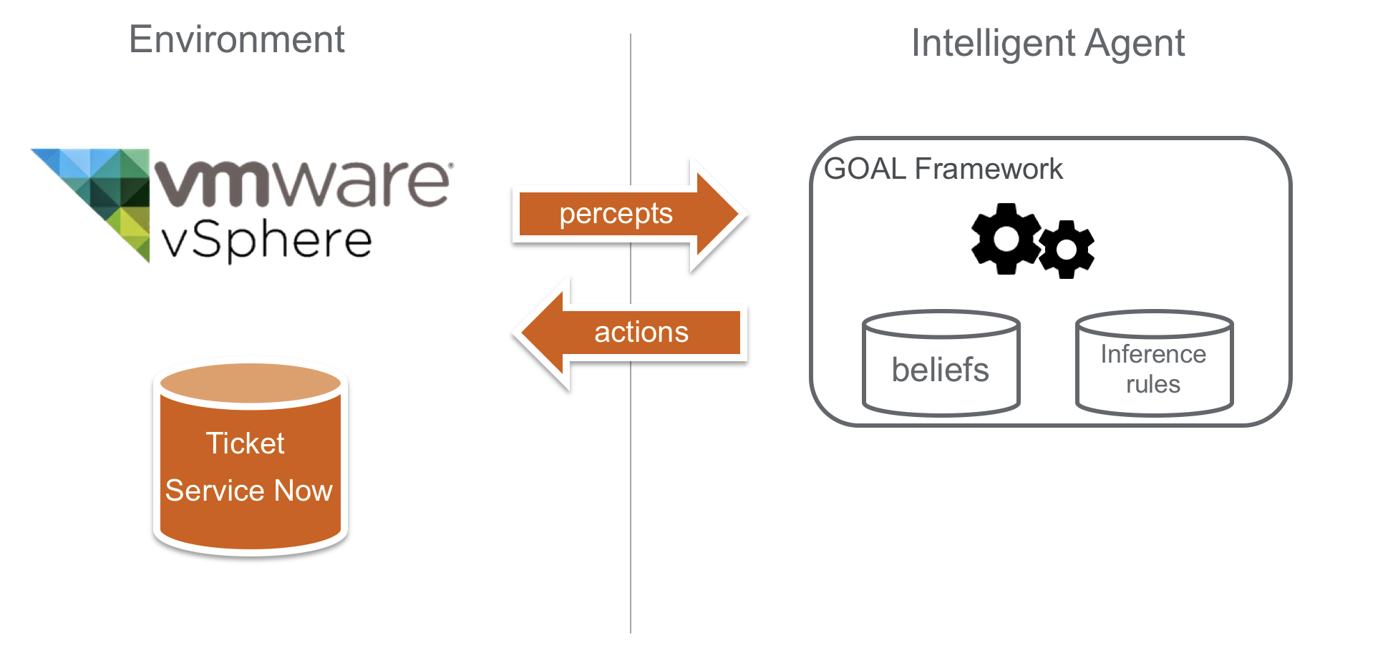

Slide 13
VMWare Intelligent Agent Demo
https://vmware-cognative-rational-service.ocp-ctc-core.optum.com/

Slide 14
Software Framework for VMWare IA
Goal Agent
perceive()
alert()
perceive()
VMWare cluster
Groovy script
Environment
Interface
Standard
action()
API
alert()
Web Interface
action()
command()
command()

Slide 15
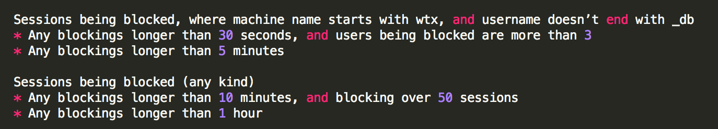
Database Infrastructure Use Case
Oracle Databases gets locked up by massive queries that blocks other sessions and users.
Apply intelligent agent to identify blocking sessions and mitigate them.

Slide 16
CSP Intelligent Agent Demo

Slide 17
Takeaways and Summary
Key Points
Intelligent Agents are high level software abstraction for building autonomous entity with varying cognitive abilities.
Intelligent Agents can handle complex environment, because it is designed around reactivity and proactiveness.
The brain of different Intelligent Agents may differ from solution to solution, but all of them share the same event driven paradigm.
Working memory is an important aspect of Intelligent Agent, that allows for simulation of cognitive intelligence.

Slide 18
Questions
& Answers

Slide 19


We need your feedback!
Open the mobile app.
Select the session.
Tap the Take Survey button. (at the bottom of the screen)
Take Survey

Slide 20
Thank you.
Optum ATC
Triet Pham
Software Engineer in AI/ML
Contact information:
triet.pham@optum.com

Slide 21
References on Intelligent Agents
Recommended articles/tutorials:
https://www.geeksforgeeks.org/agents-artificial-intelligence/
http://www.mind.ilstu.edu/curriculum/ants_nasa/intelligent_agents.php
https://www.tutorialspoint.com/artificial_intelligence/artificial_intelligence_agents_and_environments.htm
Recommended books/readings:
Is it an Agent, or just a Program?: A Taxonomy for Autonomous Agents by Stan Franklin and Art Graesser
Software Agents: An Overview by Hyacinth S. Nwana
Intelligent agents as innovations by Alexander Serenko and Brian Detlor
Intelligent agents: theory and practice by Michael Woolridge and Nicholas R. Jennings
Agent programming languages and framework that we’ve used:
https://eclipseclp.org/
https://goalapl.atlassian.net/wiki/spaces/GOAL/overview
https://jade.tilab.com/

